Slide 1

Compiler Construction CS-310 Compiler Principles, Techniques, and Tools, 2nd Edition Alfred V. Aho, Ravi Sethi, Jeffrey D. Ullman
Sir Syed University of Engineering & Technology, Karachi
Chapter 1 Introduction toChapter 1 Introduction to
Department of Computer Science

Slide 2



Chapter 1
Compiler Definition
A compiler is a program that reads a program written in one language –– the source language –– and translates it into an equivalent program in another language –– the target language.
As an important part of this translation process, the compiler reports to its user the presence of errors in the source program.
Source Program
Compiler
Target Program
Error Messages

Slide 3
Chapter 1
Why we need compilers?
You may never write a commercial compiler, but that's not why we study compilers. We study compiler construction for the following reasons:
Writing a compiler gives a student experience with large-scale applications development. Your compiler program may be the largest program you write as a student. Experience working with really big data structures and complex interactions between algorithms will help you out on your next big programming project

Slide 4
Chapter 1
Why we need compilers?
Compiler writing is one of the shining triumphs of CS theory. It is very helpful in the solutions of different problems.
Compiler writing is a basic element of programming language research. Many language researchers write compilers for the languages they design.
Many applications have similar properties to one or more phases of a compiler, and compiler expertise and tools can help an application programmer working on other projects besides compilers.

Slide 5
Chapter 1
Why do we need a compiler?
A Computer understands only binary language and executes instructions coded in binary language. It cannot execute a single instruction given in any other form.
Therefore, we must provide instructions to the computer in binary language. Means we must write computer programs entirely in binary language (sequence of 0s and 1s).
Humans are good at giving instructions in English language, whereas computers can only process binary language.
So, there was a need of a translator that translates the computer instructions given in English language to binary language.

Slide 6
Chapter 1
Activity
Throughout the 1950’s, compilers were considered notoriously difficult programs to write.
Reading Assignment ( 15 minutes )
Who invented the first Compiler?
Which Language compiler was the first Compiler?
How many staff-years first compiler takes to implement?

Slide 7
Chapter 1
History Of Compilers
1940s : Computers programmed in assembly.
1951-2 : Grace Hopper developed A-0 for the UNIVAC 1
Answer of the reading assignment:
1957 : The first FORTRAN compiler took 18 staff-years to implement. And the team led by John Backus.
1960s : Development of the first bootstrapping compiler for LISP.

Slide 8
Chapter 1
Features of Compiler
Correctness
Speed of compilation
Preserve the correct the meaning of the code
The speed of the target code
Recognize legal and illegal program constructs
Good error reporting/handling
Code debugging help

Slide 9
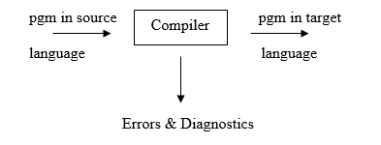
Chapter 1
Compiler and Translator
Compiler is a form of translator that translate a program written in one language “ The Source Language” to an equivalent program in a second language “ The Target language ” or “ The Object Language “
Assemblers, Compilers and Interpreters are all specific translators

Slide 10
Chapter 1
Translator
A translator is a program that takes as input a program written in one language and produces as output a program in another language. Beside program translation, the translator performs another very important role, the error-detection. Any violation of d HLL specification would be detected and reported to the programmers.

Slide 11
Chapter 1
Important role of translator
1 Translating the HLL program input into an equivalent ml program. 2 Providing diagnostic messages wherever the programmer violates specification of the HLL.

Slide 12
Chapter 1
Interpreter
An Interpreter is a program, which converts each high-level program statement into machine code just before the program statement is to be executed.
Outlining the basic working of the interpreter the above figure shows that first a source code is converted to an intermediate form and then that is executed by the interpreter.

Slide 13

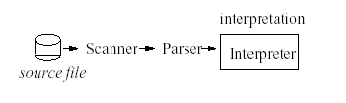
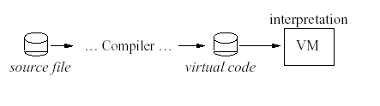
Chapter 1
Interpreter versus Compiler
Compiler
Compiler translates to machine code.
Interpreter
Interpreter executes source code directly.
Variant: Interpretation of intermediate code
Compiler generates code for a "virtual machine" (VM)
VM is simulated by software

Slide 14
Chapter 1
Interpreter VS Compiler
Compiler | Interpreter
Compiler converts all the statements in source code to object code and finally in executable code resulting an .exe file | Interpreter converts each statements before executing it. It does not produce an .exe file
Compiler requires some time before producing an executable program. | Interpreter can execute a program immediately.

Slide 15
Chapter 1
Interpreter VS Compiler
Compiler | Interpreter
Once compiled, program does not require recompile for next run. Therefore executable programs produced by compilers run much faster and efficient. | For running next time, it is required to repeat the process from the beginning. So it is slower process.

Slide 16
Chapter 1
Languages involved in Compiler
3 languages are involved in a compiler
1. Source language: Read by compiler
2. Target or Object language: translated by compiler /translator to another language
3. Host Language: Language in which compiler is written

Slide 17
Chapter 1
Task of Compiler
Breaks up the up the source program into pieces and impose grammatical structure on them.
Allows you to construct the desired target program from the intermediate representation and also create the symbol table.
Compiles source code and detects errors in it.
Manage storage of all variables and codes.
Support for separate compilation.
Read, analyze the entire program, and translate to semantically equivalent.
Translating the source code into object code depending upon the type of machine.

Slide 18
Chapter 1
Advantages and Disadvantages
Advantages of Compiler
Conciseness which improves programmer productivity, semantic restriction
Translate and analyze H.L.L.(source pgm) only once and then run the equivalent m/c code produce by compiler
Disadvantage of Compiler
Slower speed
Size of compiler and compiled code
Debugging involves all source code

Slide 19
Chapter 1
Classification Of Compilers
Compilers are sometimes classified as :
Single Pass
Two Pass
Multi Pass
Load and Go
Debugging
Optimizing
The basic tasks that any compiler must perform are essentially the same.

Slide 20
Chapter 1
Single-Pass Compiler
Single Pass Compiler
In single pass Compiler source code directly transforms into machine code. For example, Pascal language.

Slide 21
Chapter 1
Two Pass Compiler
IR
Source Program
Front End
Back End
Target Program
Two Pass Compiler
Two pass Compiler is divided into two sections:
Front end: It maps legal code into Intermediate Representation (IR).
Back end: It maps IR onto the target machine
The Two pass compiler method also simplifies the retargeting process. It also allows multiple front ends.

Slide 22
Chapter 1
Multi-Pass Compilers
Source Program
IR
IR
Target
Program
Front End
Middle End
Back End
Errors
Multi Pass Compiler
The multi pass compiler processes the source code or syntax tree of a program several times. It divided a large program into multiple small programs and process them. It develops multiple intermediate codes. All of these multi pass take the output of the previous phase as an input. So it requires less memory. It is also known as 'Wide Compiler'.

Slide 23
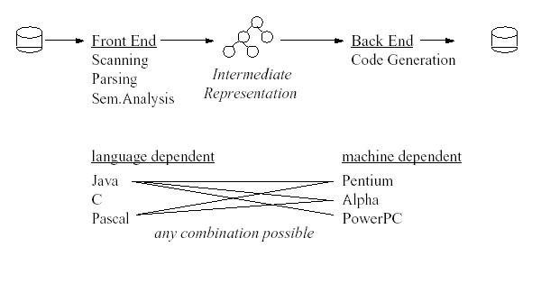
Chapter 1
Today: Often Two-Pass Compilers

Slide 24
Chapter 1
Interpreted Code Compiler
Advantages
Many combinations between front ends and back ends possible.
Optimizations are easier on the intermediate representation than on
Better portability.
Source code.
Disadvantages
Slower
Needs more memory

Slide 25
Chapter 1
Interpreted Code Compiler
Alternate Approach
Use of compiler + interpreter combine
Compiler translate H.L.L into low level intermediate code and not to m/c code.
The intermediate code is then interpreted.
Not time consuming.
Pascal
C
JAVA
Compiler
Byte Code
MIPS
SPARC
Power PC
Interpreted

Slide 26
Chapter 1
Compilation
The compilation process is a sequence of various phases. Each phase takes input from its previous stage, has its own representation of source program, and feeds its output to the next phase of the compiler. Let us understand the phases of a compiler.

Slide 27
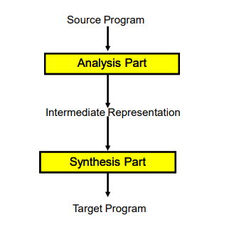
Chapter 1
The Analysis – Synthesis Model of Compilation
There are two parts of compilation. 1. Analysis part 2. Synthesis Part

Slide 28
Chapter 1
The Analysis
Analysis (Machine Independent/Language Dependent) The analysis part breaks up the source program into constant piece and creates an intermediate representation of the source program.

Slide 29
Chapter 1
The Synthesis
Synthesis(Machine Dependent/Language independent) The synthesis part constructs the desired target program from the intermediate representation.

Slide 30
Chapter 1
Major Types of Compiler
Self-resident Compiler:
generates Target code for the same m/c or host.
2. Cross Compilers:
generates target code for m/c other then host.

Slide 31
Chapter 1
Major Types of Compiler
Self-resident Compiler:
Self resident Compiler are compilers that generates code for the same Platform on which it runs. It converts high language into computer’s native language. For example Turbo C or GCC compiler.

Slide 32
Chapter 1
Major Types of Compiler
Cross Compilers:
A Cross compiler is a compiler that generates executable code for a platform other than one on which the compiler is running. For example a compiler that running on Linux/x86 box is building a program which will run on a separate Arduino/ARM.

Slide 33
Chapter 1
Major Types of Compiler
Self resident Compiler | Cross compiler
Translates program for same hardware/platform/machine on it is running. | Translates program for different hardware/platform/machine other than the platform which it is running.
It is used to build programs for same system/machine & OS it is installed. | It is used to build programs for other system/machine like AVR/ARM.
It is dependent on System/machine and OS. | It is independent of System/machine and OS.
It can generate executable file like .exe. | It can generate raw code .hex.
TurboC or GCC is native Compiler. | Java is the Best e.g.

Slide 34
Chapter 1
Activity
Reading Assignment ( 1 hour )
Now a day we use cross-platform development framework for development of mobile application.
Name any framework and discuss how that framework compiles the code for different operating systems.
Your Analysis will be discussed in the class.

Slide 35
Chapter 1
Analysis of the Source Program
In Compiling, analysis consist of three phases:
Lexical Analysis
Syntax Analysis
Semantic Analysis

Slide 36
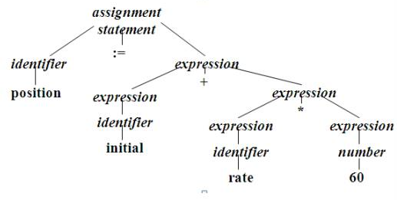
Chapter 1
Analysis of the Source Program
Lexical Analysis
In a compiler linear analysis is called lexical analysis or scanning.
The lexical analysis phase reads the characters in the source program and grouped into them tokens that are sequence of characters having a collective meaning.
For Example:
position : = initial + rate * 60
Identifiers – position, initial, rate.
Operators - + , *
Assignment symbol - : =
Number - 60
Blanks – eliminated.
Parse tree for position : = initial + rate*60

Slide 37
Chapter 1
Analysis of the Source Program
Syntax Analysis
Hierarchical Analysis is called parsing or syntax analysis.
It involves grouping the tokens of the source program into grammatical phrases that are used by the complier to synthesize output.
They are represented using a syntax tree as shown in above figure.
· A syntax tree is the tree generated as a result of syntax analysis in which the interior nodes are the operators and the exterior nodes are the operands.
· This analysis shows an error when the syntax is incorrect.
For Example:
position : = initial + rate * 60

Slide 38
Chapter 1
Analysis of the Source Program
Semantic Analysis
This phase checks the source program for semantic errors and gathers type information for subsequent code generation phase.
An important component of semantic analysis is type checking. Here the compiler checks that each operator has operands that are permitted by the source language specification.

Slide 39
Chapter 1
Parts of Compiler
Analysis – Synthesis `model of compilation
2 parts of compilation process
Analysis
Synthesis
Analysis:
Breaks up source pgm into constituent pieces.
Creates intermediate representation of source pgm.
Synthesis:
Construct target pgm from intermediate representation.

Slide 40
Chapter 1
A Language Processing System
I/P=HLL/Source Code
Pre-Processor
Pure HLL
Compiler
Assembly Language/ Low Level Language
Assembler
Relocatable m/c code
Loader/Linker
Executable code/absolute m/c code

Slide 41
Chapter 1
A Language Processing System
Preprocessor
Produce I/p to compiler. They may perform
Macro processing: shorthand for longer construct.
File inclusion: separate module can be used by including their file for example: #include <iostream>
Rational preprocessors: give support for additional facilities which are not included in compiler itself.
Language Extension: may include extra capabilities.

Slide 42
Chapter 1
A Language Processing System
Assembler
I/p from compiler in form of Assembly code.
Produce object file or relocatable m/c code for example: loading can start at any location in memory.

Slide 43
Chapter 1
A Language Processing System
Loader/Linker Editor:
Performs 2 functions :
Loading:
Relocatable code is converted to absolute code i.e. placed at their specified position.
2. Link-Editor:
Make single pgm from several files of relocatable m/c code.
The file may be o/p of different compilation.
May be Library files or routine provided by system.
Result is executable file.

Slide 44
Chapter 1
FAQ
What is compiler?
What are the two parts of the compilation?
List the subparts or phases of analysis part?
What is the linear analysis?
What are the classifications of a compiler?
Compiler should report the presence of __________ in the source program, in translation process.
Classes
Objects
Errors
Text
Compiler translates the source code to?
Executable code
Machine code
Binary Code
Both B and C

Slide 45
Thank You

